Slide 1

Smart Dustbin
Electronic Workshop
Project
Team Name – Eco Warriors
Abhishek Sharma(2022102004)
Himanshu Yadav (2022102010)

Slide 2
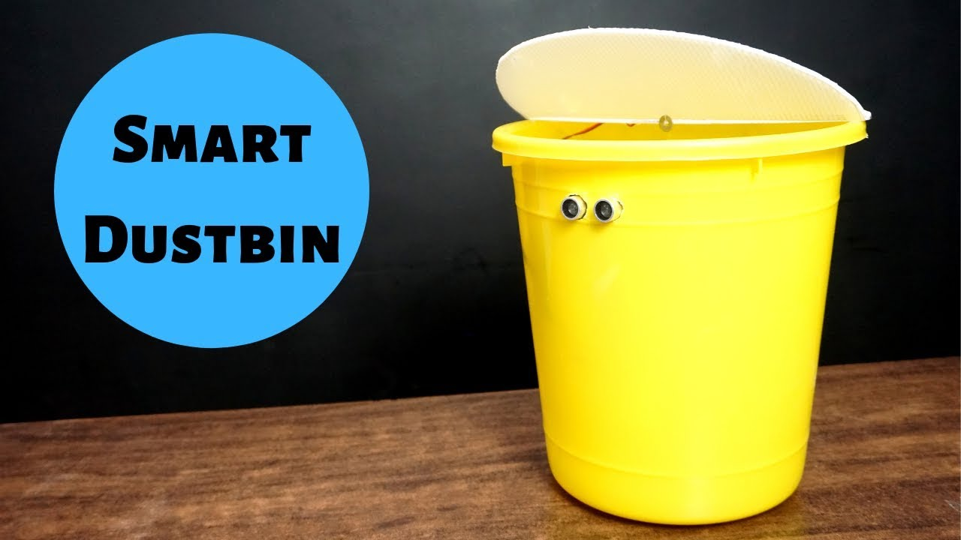
Abstract
A dustbin whose lid opens without any effort, on sensing the object or by switching on with the connected Bluetooth device and even tells you how much the dustbin is already filled. This clearly increases the sanitation as we need not touch the dustbin to put the garbage in and the lid automatically closes as soon as the object is put inside.

Slide 3
Components required
Arduino Uno -1
Ultrasonic Sensor – 2
Bluetooth module (HC-05) -1
Micro Servo motor -1
LCD display
Buzzer – 1
9 Volt Battery -1
Bucket for dustbin (small) -1
Cardboard - 1

Slide 4
Implementation
The object is detected by ultrasonic sensor, and it measures the distance of the object from the dustbin and using that distance the Arduino decides whether to open the lid or not.
For getting the information about how much the dustbin is filled, another ultrasonic sensor is used on the top of the dustbin which measures the distance between the garbage and the lid of the dustbin and using that distance, different signals can be generated using RGB LED (different colours for the different levels) and Buzzer (to indicate the dustbin is full) when the dustbin is taken in use.

Slide 5
Time-Line
18th Jan -: Selection of “Smart Dustbin” as project topic.
19th Jan -: Verifying the project from TAs and adding feature for indication of how much the dustbin is filled.
21st Jan -: Addition of the feature Bluetooth connection to open it with the device connected with the Bluetooth.
22nd Jan -: Preparing presentation and a circuit diagram for the project proposal presentation.
23rd to 30th Jan-: Working on the theory and completing the code of the project.
30th Jan -: Receiving all the components and starting the 3-D model of project.
1st Feb -: Incorporating ultrasonic sensors and Arduino in the dustbin.
6th Feb -: Incorporating Bluetooth components in the dustbin and completing the 3-D model.
13th Feb -: Presenting the project for the final evaluation.

Slide 6
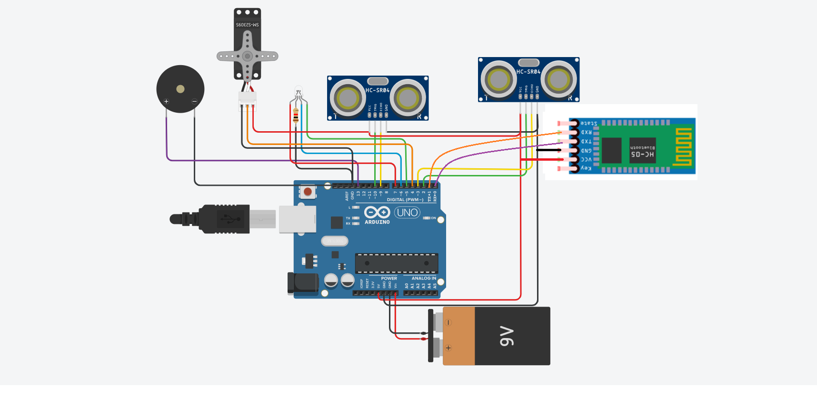
Circuit Diagram
Link To TinkerCad

